Slide 1
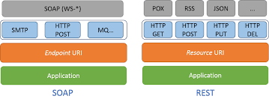
SOAP & REST

Slide 2
Agenda
SOA Architecture
Introduction to Web Services
SOAP Introduction, SOAP Message
WSDL - Web Services Development using SOAP
JAX WS Implementation for SOAP
Introduction to REST API features and Principles
SOAP Vs REST
REST API Methods, HTTP Status codes
Truly RESTful API, POSTMAN as an API Testing tool
JAX-RS Servlet containers, JAX-RS Annotations
JAX-RS Media Types

Slide 3
Introduction to web services
Web service is a technology to communicate one programming language with another.
For example, java programming language can interact with PHP and .Net by using web services.
In other words, web service provides a way to achieve interoperability.
web services such as protocols, SOAP, RESTful, java web service implementation, JAX-WS and JAX-RS
java web services and its specifications such as JAX-WS and JAX-RS.
There are two ways to write the code for JAX-WS by RPC style and Document style. Like JAX-WS, JAX-RS can be written by Jersey and RESTeasy.

Slide 4
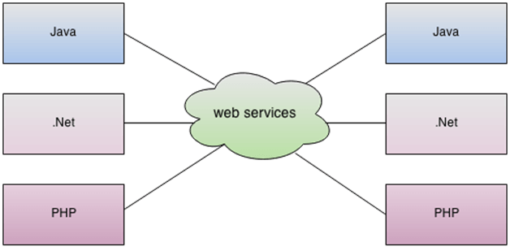

Slide 5
What is Web Service
It is a client-server application or application component for communication.
The method of communication between two devices over the network.
It is a software system for the interoperable machine to machine communication.
It is a collection of standards or protocols for exchanging information between two devices or application.

Slide 6
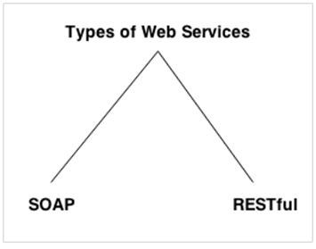
Types of Web Services

Slide 7
Web Service Features
XML-Based
Web services use XML at data description and data transportation layers. Using XML exclude any networking, operating system, or platform binding. Web services-based operation is extremely interoperable at their core level.

Slide 8
Loosely Coupled
A client of a web service is not fixed to the web service directly.
The web service interface can support innovation over time without negotiating the client's ability to communicate with the service.
A tightly coupled system means that the client and server logic are closely tied to one another, indicating that if one interface changes, then another must be updated.
Accepting a loosely coupled architecture tends to make software systems more manageable and allows more straightforward integration between various systems.

Slide 9
Coarse-Grained
Object-oriented technologies such as Java expose their functions through individual methods.
A specific process is too fine an operation to provide any suitable capability at a corporate level.
Building a Java program from scratch needed the creation of various fine-grained functions that are then collected into a coarse-grained role that is consumed by either a client or another service.

Slide 10
Ability to be Synchronous or Asynchronous
Synchronicity specifies the binding of the client to the execution of the function.
In synchronous invocations, the client blocks and delays in completing its service before continuing.
Asynchronous operations grant a client to invoke a task and then execute other functions.
Asynchronous clients fetch their result at a later point in time, while synchronous clients receive their effect when the service has completed.
Asynchronous capability is an essential method in enabling loosely coupled systems.

Slide 11
Supports Remote Procedure Calls (RPCs)
Web services allow consumers to invoke procedures, functions, and methods on remote objects using an XML-based protocol.
Remote systems expose input and output framework that a web service must support.
Component development through Enterprise JavaBeans (EJBs) and .NET Components has more become a part of architectures and enterprise deployments over a previous couple of years.
Both technologies are assigned and accessible through a variety of RPC mechanisms.

Slide 12
Web Service Components
There are three major web service components.
SOAP
WSDL
UDDI

Slide 13
SOAP
SOAP is an acronym for Simple Object Access Protocol.
SOAP is a XML-based protocol for accessing web services.
SOAP is a W3C recommendation for communication between applications.
SOAP is XML based, so it is platform independent and language independent. In other words, it can be used with Java, .Net or PHP language on any platform.

Slide 14
WSDL
WSDL is an acronym for Web Services Description Language.
WSDL is a xml document containing information about web services such as method name, method parameter and how to access it.
WSDL is a part of UDDI. It acts as a interface between web service applications.
WSDL is pronounced as wiz-dull.

Slide 15
UDDI
UDDI is an acronym for Universal Description, Discovery and Integration.
UDDI is a XML based framework for describing, discovering and integrating web services.
UDDI is a directory of web service interfaces described by WSDL, containing information about web services.

Slide 16
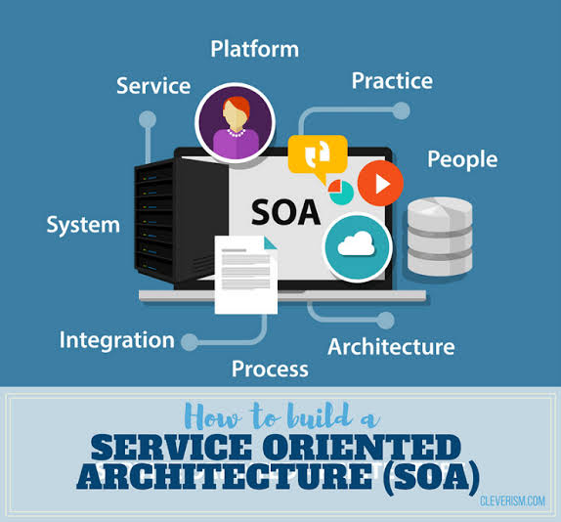
SOA

Slide 17
What is Service?
A service is a well-defined, self-contained function that represents a unit of functionality.
A service can exchange information from another service. It is not dependent on the state of another service.
It uses a loosely coupled, message-based communication model to communicate with applications and other services.

Slide 18
Service Oriented Architecture (SOA)
Service-Oriented Architecture (SOA) is an architectural approach in which applications make use of services available in the network.
In this architecture, services are provided to form applications, through a communication call over the internet.

Slide 19
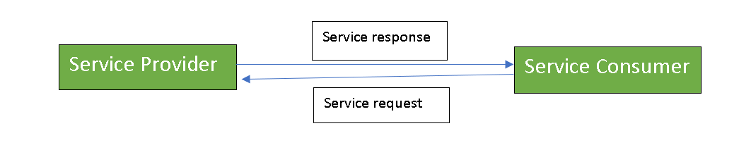

Service Connections
There are two major roles within Service-oriented Architecture:

Slide 20
Service provider: The service provider is the maintainer of the service and the organization that makes available one or more services for others to use. To advertise services, the provider can publish them in a registry, together with a service contract that specifies the nature of the service, how to use it, the requirements for the service, and the fees charged.
Service consumer: The service consumer can locate the service metadata in the registry and develop the required client components to bind and use the service.

Slide 21
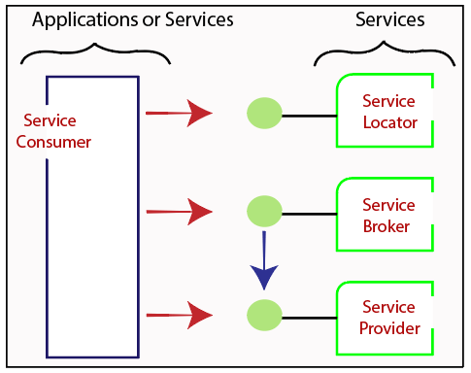
Service-Oriented Terminologies

Slide 22
Services - The services are the logical entities defined by one or more published interfaces.
Service provider - It is a software entity that implements a service specification.
Service consumer - It can be called as a requestor or client that calls a service provider. A service consumer can be another service or an end-user application.
Service locator - It is a service provider that acts as a registry. It is responsible for examining service provider interfaces and service locations.
Service broker - It is a service provider that pass service requests to one or more additional service providers.

Slide 23
Characteristics of SOA
They are loosely coupled.
They support interoperability.
They are location-transparent
They are self-contained

Slide 24
SOA Architect
SOA architecture is viewed as five horizontal layers. These are described below:
Consumer Interface Layer: These are GUI based apps for end users accessing the applications.
Business Process Layer: These are business-use cases in terms of application.
Services Layer: These are whole-enterprise, in service inventory.
Service Component Layer: are used to build the services, such as functional and technical libraries.
Operational Systems Layer: It contains the data model.

Slide 25
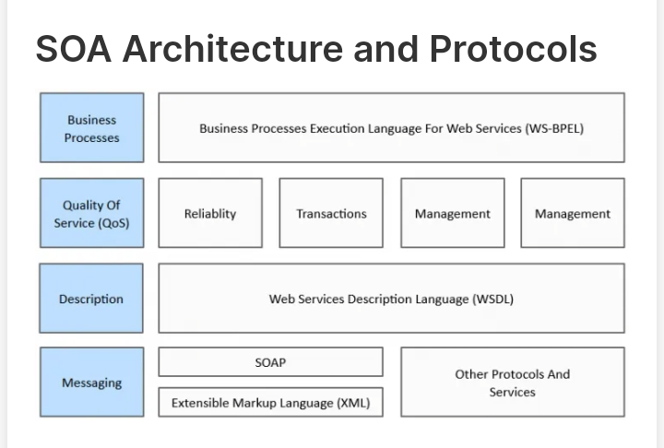

Slide 26
Components of service-oriented architecture
The functional aspect contains:
Transport - It transports the service requests from the service consumer to the service provider and service responses from the service provider to the service consumer.
Service Communication Protocol - It allows the service provider and the service consumer to communicate with each other.
Service Description - It describes the service and data required to invoke it.
Service - It is an actual service.
Business Process - It represents the group of services called in a particular sequence associated with the particular rules to meet the business requirements.
Service Registry - It contains the description of data which is used by service providers to publish their services.

Slide 27
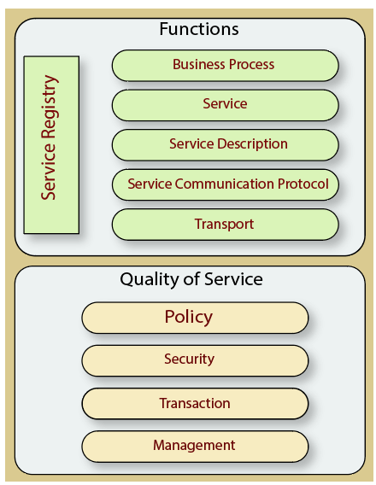

Slide 28
The quality of service aspects contains:
Policy - It represents the set of protocols according to which a service provider make and provide the services to consumers.
Security - It represents the set of protocols required for identification and authorization.
Transaction - It provides the surety of consistent result. This means, if we use the group of services to complete a business function, either all must complete or none of the complete.
Management - It defines the set of attributes used to manage the services.

Slide 29
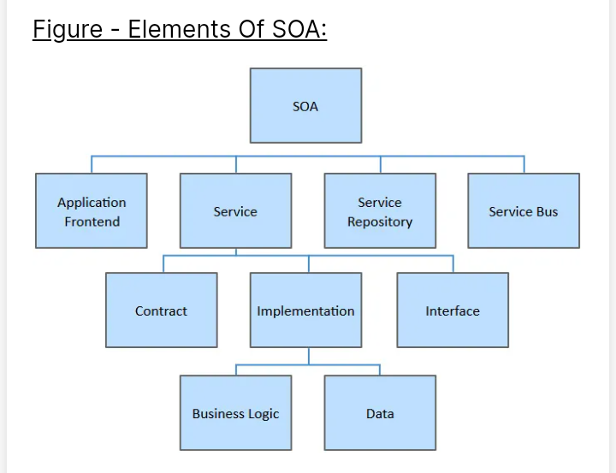

Slide 30
Advantages of SOA
Easy to integrate - In a service-oriented architecture, the integration is a service specification that provides implementation transparency.
Manage Complexity - Due to service specification, the complexities get isolated, and integration becomes more manageable.
Platform Independence - The services are platform-independent as they can communicate with other applications through a common language.
Loose coupling - It facilitates to implement services without impacting other applications or services.
Parallel Development - As SOA follows layer-based architecture, it provides parallel development.
Available - The SOA services are easily available to any requester.
Reliable - As services are small in size, it is easier to test and debug them.

Slide 31
SOAP
SOAP stands for Simple Object Access Protocol

Slide 32
SOAP Web Services
SOAP stands for Simple Object Access Protocol. It is a XML-based protocol for accessing web services.
SOAP is a W3C recommendation for communication between two applications.
SOAP is XML based protocol. It is platform independent and language independent. By using SOAP, you will be able to interact with other programming language applications.

Slide 33
Why SOAP?
It is important for web applications to be able to communicate over the Internet.
The best way to communicate between applications is over HTTP, because HTTP is supported by all Internet browsers and servers.
SOAP was created to accomplish this.
SOAP provides a way to communicate between applications running on different operating systems, with different technologies and programming languages.

Slide 34
SOAP Building Blocks
An Envelope element that identifies the XML document as a SOAP message
A Header element that contains header information
A Body element that contains call and response information
A Fault element containing errors and status information

Slide 35
Syntax Rules
A SOAP message MUST be encoded using XML
A SOAP message MUST use the SOAP Envelope namespace
A SOAP message must NOT contain a DTD reference
A SOAP message must NOT contain XML Processing Instructions

Slide 36
The structure of a SOAP message
A SOAP message is encoded as an XML document, consisting of an <Envelope> element, which contains an optional <Header> element, and a mandatory <Body> element.
The <Fault> element, contained in <Body>, is used for reporting errors.
XML elements in <Header> and <Body> are defined by the applications that make use of them, although the SOAP specification imposes some constraints on their structure.

Slide 37
The SOAP envelope:<Envelope> is the root element in every SOAP message, and contains two child elements, an optional <Header> element, and a mandatory <Body> element.
The SOAP header:<Header> is an optional subelement of the SOAP envelope, and is used to pass application-related information that is to be processed by SOAP nodes along the message path; see The SOAP header.
The SOAP body:<Body> is a mandatory subelement of the SOAP envelope, which contains information intended for the ultimate recipient of the message; see The SOAP body.
The SOAP fault:<Fault> is a subelement of the SOAP body, which is used for reporting errors; see The SOAP fault.

Slide 38
<?xml version="1.0"?>
<soap:Envelope
xmlns:soap="http://www.w3.org/2003/05/soap-envelope/"
soap:encodingStyle="http://www.w3.org/2003/05/soap-encoding">
<soap:Header>
...
</soap:Header>
<soap:Body>
...
<soap:Fault>
...
</soap:Fault>
</soap:Body>
</soap:Envelope>

Slide 39
Advantages of Soap Web Services
WS Security: SOAP defines its own security known as WS Security.
Language and Platform independent: SOAP web services can be written in any programming language and executed in any platform.

Slide 40
Disadvantages of Soap Web Services
Slow: SOAP uses XML format that must be parsed to be read. It defines many standards that must be followed while developing the SOAP applications. So it is slow and consumes more bandwidth and resource.
WSDL dependent: SOAP uses WSDL and doesn't have any other mechanism to discover the service.

Slide 41
REST
REpresentational State Transfer.

Slide 42
RESTful Web Services
REST stands for REpresentational State Transfer.
REST is an architectural style not a protocol

Slide 43
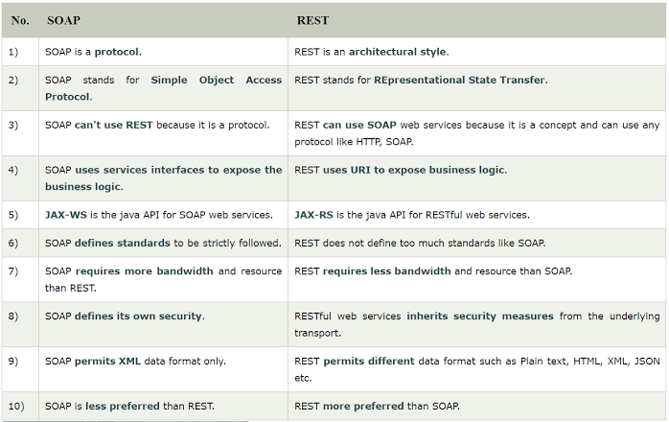

Slide 44
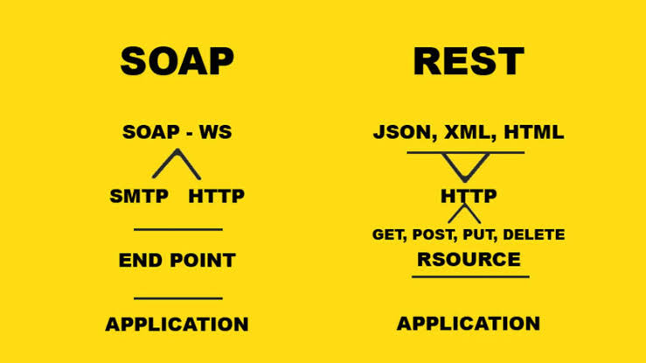

Slide 45
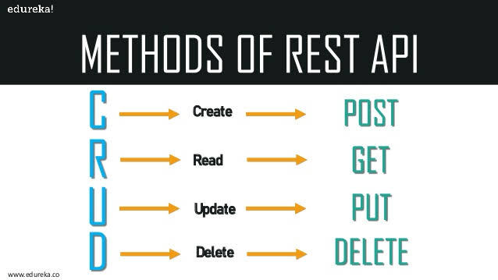

Slide 46
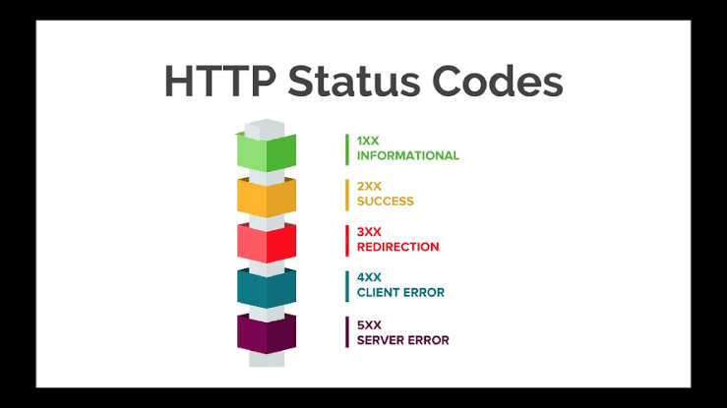

Slide 47
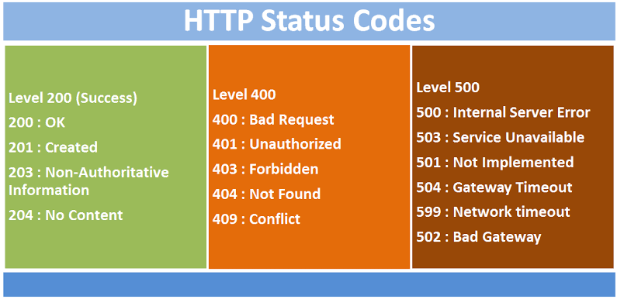

Slide 48
POSTMAN as API testing tool

Slide 49
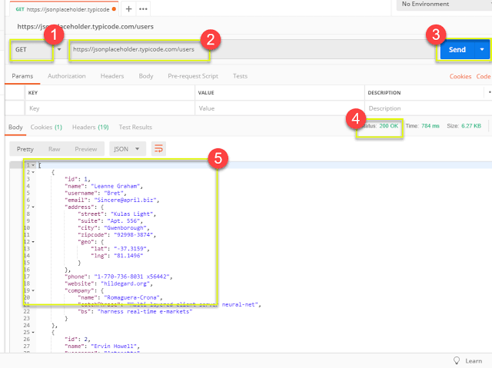

Slide 51
What is the use of JAX-RS?
Jakarta RESTful Web Services
JAX-RS is a Java programming language API designed to make it easy to develop applications that use the REST architecture.
The JAX-RS API uses Java programming language annotations to simplify the development of RESTful web services.

Slide 52
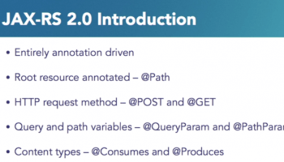

Slide 53
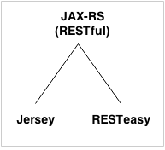
JAX-RS

Slide 54
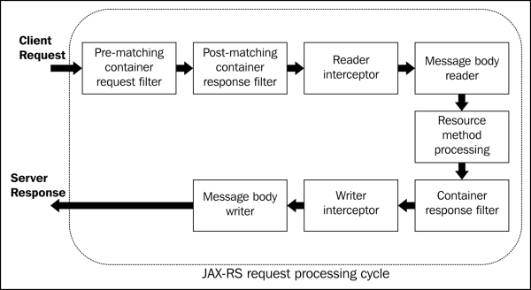

Slide 55
Specification
JAX-RS provides some annotations to aid in mapping a resource class (a POJO) as a web resource.
The annotations use the Java package javax.ws.rs. They include:
@Path specifies the relative path for a resource class or method.
@GET, @PUT, @POST, @DELETE and @HEAD specify the HTTP request type of a resource.
@Produces specifies the response Internet media types (used for content negotiation).
@Consumes specifies the accepted request Internet media types.

Slide 56
In addition, it provides further annotations to method parameters to pull information out of the request.
All the @*Param annotations take a key of some form which is used to look up the value required.
@PathParam binds the method parameter to a path segment.
@QueryParam binds the method parameter to the value of an HTTP query parameter.
@MatrixParam binds the method parameter to the value of an HTTP matrix parameter.
@HeaderParam binds the method parameter to an HTTP header value.
@CookieParam binds the method parameter to a cookie value.
@FormParam binds the method parameter to a form value.
@DefaultValue specifies a default value for the above bindings when the key is not found.
@Context returns the entire context of the object (for example @Context HttpServletRequest request).

Slide 57
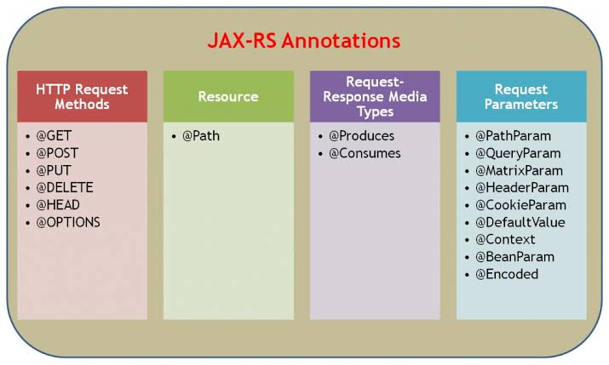

Slide 58
